Slide 1
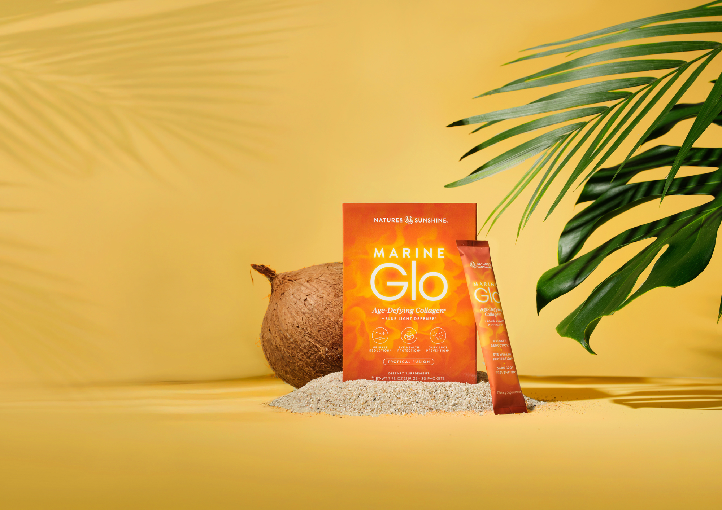

Slide 2
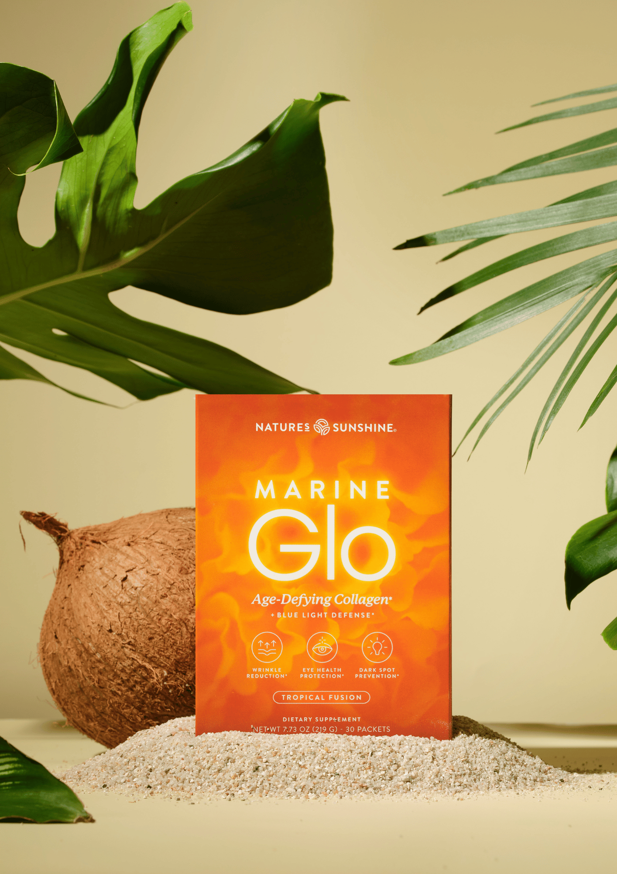
Marine Glo™
Beauty starts with health
Comprehensive support for the body thanks to a combination of:
• 5 g of hydrolyzed marine collagen
• FloraGLO® Lutein
• vitamin C
• biotin
• niacin
Notes:
Marine Glo is not just another "drinkable collagen." It's a product designed for people who want to consciously take care of their skin, hair, and daily diet. The manufacturer combined five ingredients that complement each other. Today, we won't be talking only about collagen. We'll talk about skin biology and why collagen alone is often not enough.

Slide 3

Skin — the body’s largest organ
The skin performs far more functions than just aesthetic ones.
Key functions of the skin
✔ protects the body from external factors
✔ helps prevent water loss
✔ plays a role in thermoregulation
✔ contributes to vitamin D synthesis
✔ forms part of the immune system
✔ receives stimuli from the environment
Did you know that…?
• the surface area of an adult’s skin is approximately 2 m²
• the skin weighs around 4–5 kg
• we lose millions of epidermal cells every day
Notes:
Most people see the skin just as a part of their appearance. Meanwhile, it's the largest organ in our body. Its condition depends not only on cosmetics but also on the nourishment of the body.

Slide 4
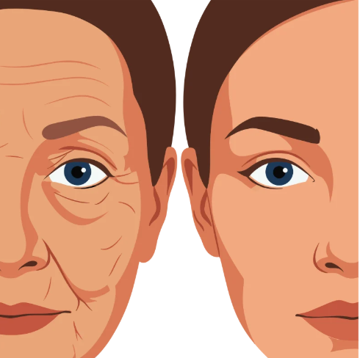
Why does skin age?
The aging process is natural.
It is influenced by both internal and environmental factors.
Internal factors
• age
• genetics
• hormones
External factors
• UV radiation
• environmental pollution
• oxidative stress
• chronic stress
• an unhealthy diet
• lack of sleep
• smoking
Notes:
There are some factors we can't influence. However, we can affect many through our lifestyle and proper diet.

Slide 5
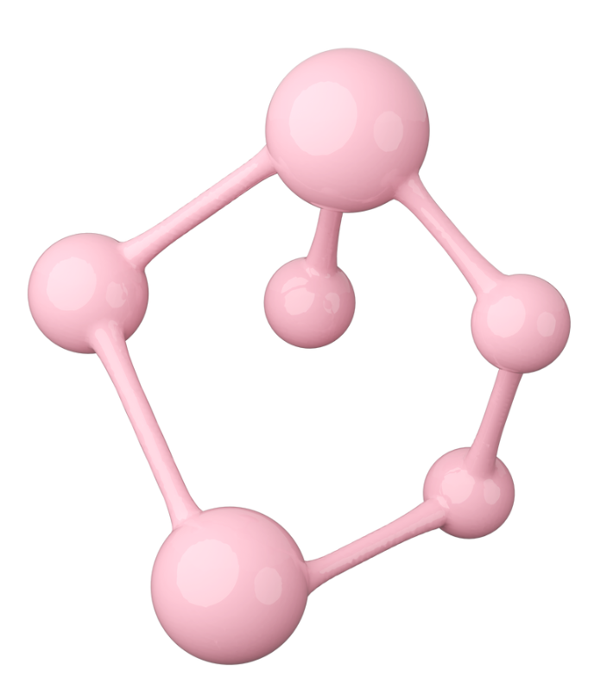
What is collagen?
Collagen is the most abundant protein in the human body.
It accounts for approximately 30% of all proteins in the body.
It is the main structural component of connective tissue.
It is found in, among others:
✔ skin
✔ bones
✔ cartilage
✔ tendons
✔ ligaments
✔ blood vessels
Notes:
Collagen can be compared to the framework of a building. It's what gives structure to many tissues.

Slide 6

Types of collagen
More than 28 types of collagen have been described to date.
The most important ones include:
Type I
✔ skin
✔ bones
✔ tendons
✔ ligaments
Accounts for approximately 90% of the collagen in the body.
Type II
✔ articular cartilage
Type III
✔ skin
✔ blood vessels
✔ internal organs
Notes:
Marine Glo contains fish collagen, which is a natural source mainly of type I collagen – the one that dominates in the skin.

Slide 7
What happens to collagen as we get older?
Natural collagen production does not remain constant throughout life.
After around the age of 25, it gradually begins to decline.
The rate of this process is influenced by factors such as:
• age
• UV radiation
• oxidative stress
• smoking
• diet
• environmental pollution
Did you know…?
That's exactly why the daily intake of nutrients that support the proper functioning of the body is so important.Czy wiesz, że…?
Notes:
We're not saying that Marine Glo stops aging. We're saying that as we get older, the body's needs change, and a properly balanced diet and nutrients are important for maintaining its normal functions.

Slide 8
Why was hydrolyzed collagen chosen?
Marine Glo contains:
5 g of hydrolyzed marine collagen per serving.
Hydrolysis is the enzymatic process of breaking down large collagen molecules into shorter peptides.
As a result:
✔ they dissolve easily in water
✔ they make a convenient drink
✔ they are a commonly used form of collagen in dietary supplements.

Slide 9
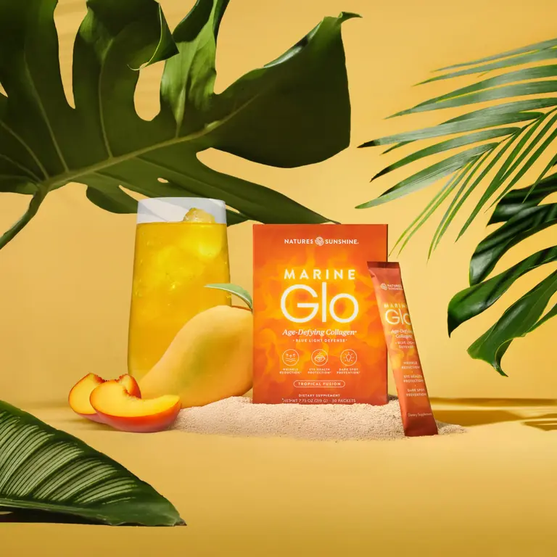
Marine Glo – more than collagen
Marine Glo™ is a carefully formulated blend of complementary ingredients.
Each sachet contains:
• 5 g of hydrolyzed marine collagen
• 10 mg of branded FloraGLO® Lutein
• 25 mg of vitamin C
• 16 mg of niacin
• 300 µg of biotin
A combination of nutrients and high-quality ingredients in a convenient form for a daily drink.
Notes:
Customers often say:
"It’s just collagen."
Our answer is:
No. Marine Glo is a comprehensive blend of nutrients, each serving a different function.

Slide 10

Why combine these ingredients?
Marine Glo is more than just collagen.
It combines:
• collagen peptides
• vitamin C
• biotin
• niacin
• FloraGLO® Lutein
Each ingredient serves a different function, allowing the product to provide multidirectional support for the body.

Slide 11
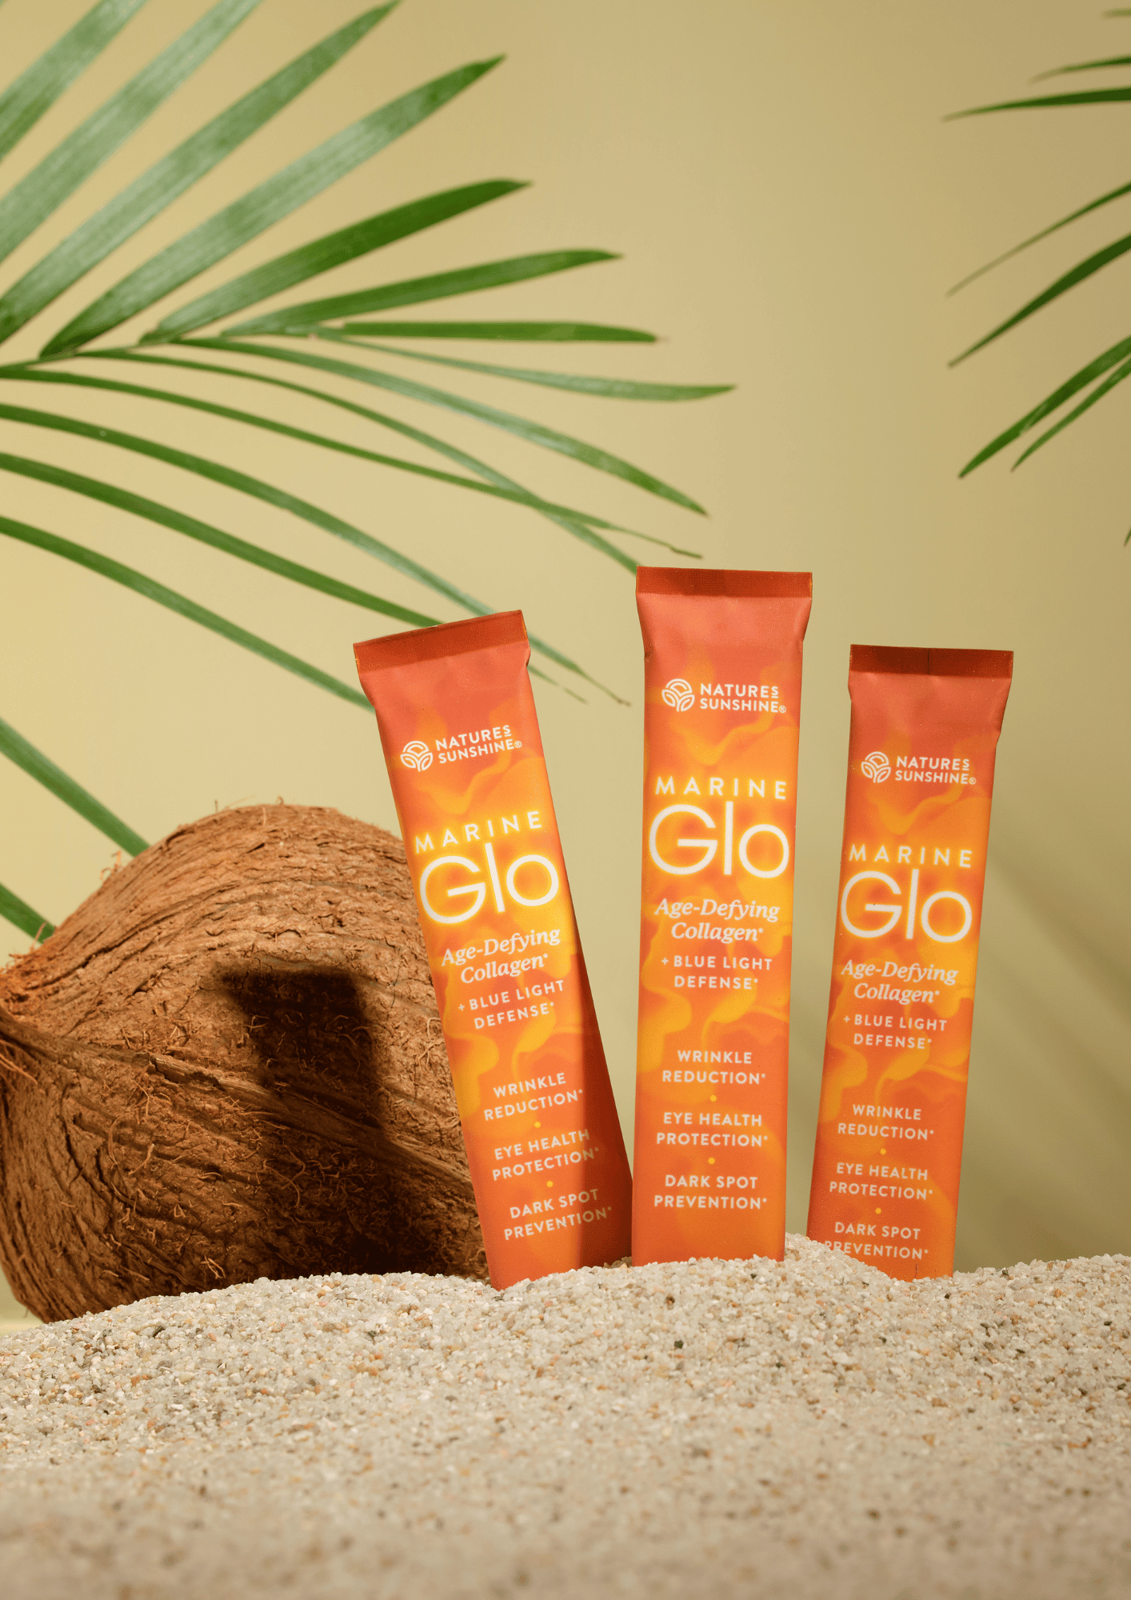
What makes Marine Glo stand out?
✔ 5 g of marine collagen
✔ only 25 kcal
✔ sugar-free
✔ gluten-free
✔ no artificial flavors
✔ no artificial colors
✔ convenient drink-mix sachets
✔ tropical flavor

Slide 12

Vitamin C – why is it so important?
Collagen does not work alone.
For normal collagen production, the body needs, among other nutrients, vitamin C.
That is why it has been added to Marine Glo.
Vitamin C:
✔ contributes to normal collagen formation for the normal function of skin, bones, cartilage, blood vessels, gums and teeth

Slide 13

Vitamin C – way more than just collagen
Vitamin C also helps:
✔ protect cells from oxidative stress
✔ support the normal function of the immune system
✔ reduce tiredness and fatigue
✔ increase iron absorption
✔ support normal energy-yielding metabolism
Did you know…?
Marine Glo provides 25 mg of vitamin C,which is about 31% of the reference intake in one sachet.

Slide 14
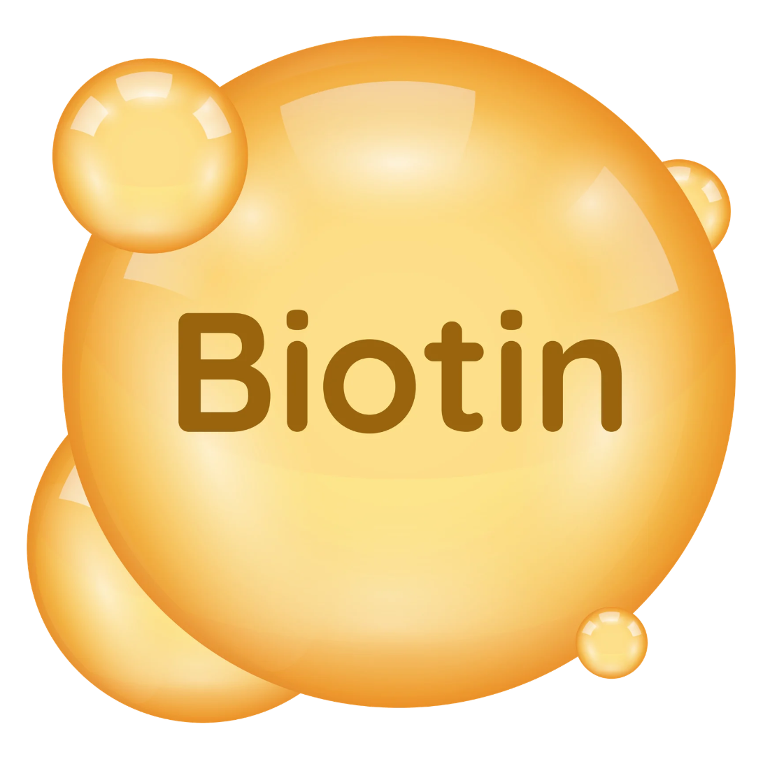
Biotin – the vitamin for beautiful skin
Biotin is a B-group vitamin.
It is a component of many enzymes involved in metabolic processes.
Biotin helps:
✔ maintain healthy skin
✔ maintain healthy hair
✔ maintain normal mucous membranes
✔ maintain normal functioning of the nervous system
✔ maintain normal macronutrient metabolism
✔ maintain normal psychological function
Did you know…?
Marine Glo provides 300 µg of biotin which is 600% of the RI.
Notes:
That's exactly why Marine Glo isn't just a 'collagen' product. Biotin has really strong, approved claims for skin and hair health.

Slide 15
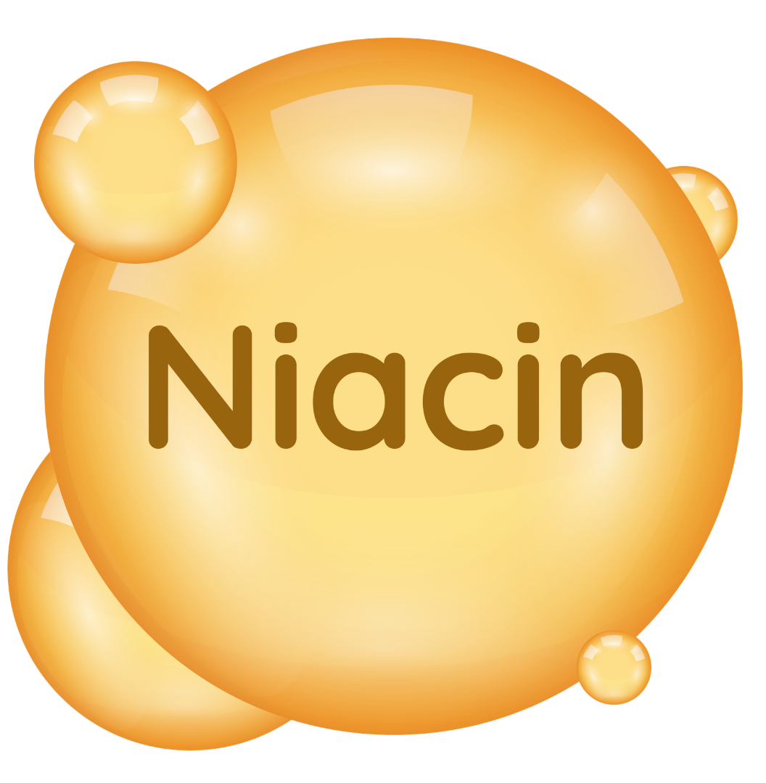
Niacin – energy and healthy skin
Niacin (vitamin B3) is involved in hundreds of metabolic reactions that take place every day.
Niacin helps:
✔ maintain healthy skin
✔ reduce tiredness and fatigue
✔ maintain normal energy-yielding metabolism
✔ maintain normal functioning of the nervous system
✔ maintain normal psychological function
✔ maintain normal energy-yielding metabolism
Did you know…Marine Glo provides 100% RWS niacin?
Notes:
This is a great moment to point out that Marine Glo supports the body not just through the skin, but also provides vitamins that help with proper energy metabolism.

Slide 16

FloraGLO® – why this particular lutein?
Not all lutein is the same.
Marine Glo contains FloraGLO®, one of the most recognized and well-researched lutein brands in the world.
FloraGLO® is a registered trademark of Kemin Industries.
Notes:
This is a huge advantage of the product. We’re not buying anonymous lutein. We’re buying a branded ingredient.

Slide 17
FloraGLO® – an ingredient with its own research backing
Marine Glo contains 10 mg of FloraGLO® Lutein.
FloraGLO® is a patented ingredient from Kemin Industries that has been the subject of scientific research on lutein for many years.
Not all lutein available on the market is the same.
FloraGLO® means:
✔ standardized raw material
✔ controlled quality
✔ traceable origin

Slide 18

What exactly is lutein?
Lutein belongs to the group of carotenoids, which are natural plant pigments.
It naturally occurs in, among others:
🥬 kale
🥬 spinach
🥦 broccoli
🌼 marigold flowers
FloraGLO® is derived from marigold flowers.

Slide 19
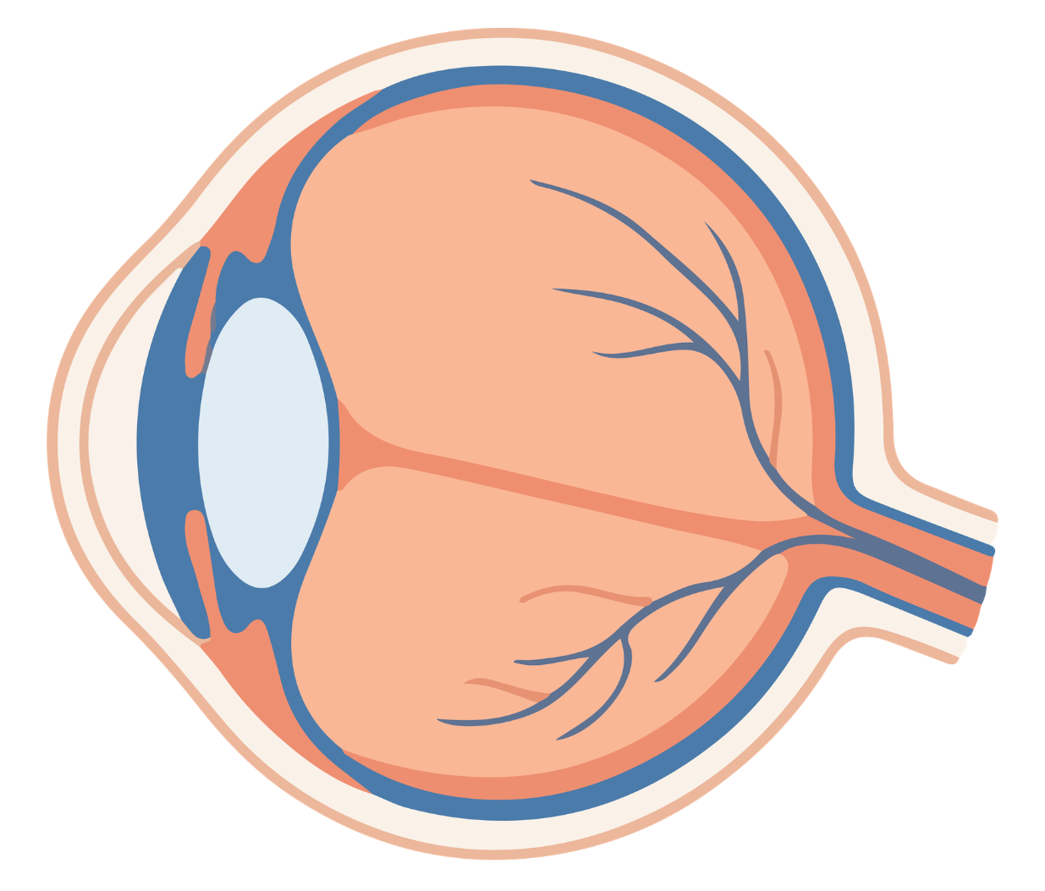
Where in the body is lutein found?
Lutein naturally accumulates primarily in:
👁 the macula of the eye
👁 the retina
and is also found in the skin.
This is one of the reasons why it has been the subject of extensive scientific research for many years.

Slide 20
Synergy of ingredients
Marine Glo isn’t based on just one ingredient. Each of them serves a different purpose.
Ingredient | Role
Marine collagen | Source of collagen peptides
Vitamin C | Contributes to normal collagen formation
Biotin | Helps maintain healthy skin and hair
Niacin | Helps maintain healthy skin and supports normal energy-yielding metabolism
FloraGLO® | Branded plant-based ingredient containing lutein

Slide 21

Why are scientists studying collagen so intensively?
Collagen is one of the most extensively studied proteins in the human body.
For many years, research has focused on:
• its structure
• its metabolism
• its role in connective tissue
• age-related changes
• the use of collagen hydrolysates in nutrition.

Slide 22

What are collagen peptides?
Collagen hydrolysate is not “whole collagen.”
During the hydrolysis process, long collagen fibers are broken down into much shorter fragments called collagen peptides.
The peptides:
✔ dissolve easily in water
✔ have a neutral taste
✔ are a commonly used form of collagen in dietary supplements.
Marine Glo provides 5 g of hydrolyzed marine collagen per serving.

Slide 23
Facts and Myths About Collagen
MYTH 1
“Collagen works immediately.”
FACT
Collagen is part of a daily diet. Supplementation does not replace a healthy lifestyle or a balanced diet. The best results are achieved through consistent use of the product according to the manufacturer’s recommendations.
MYTH 2
“All collagen is the same.”
FACT
Products differ in:
✔ source of collagen
✔ amount of collagen
✔ degree of hydrolysis
✔ additional ingredients
✔ quality of raw materials
MYTH 3
“Collagen is enough to care for your skin.”
FACT
The body also needs other nutrients. That is why Marine Glo contains vitamin C, biotin and niacin, which have approved health claims related to maintaining healthy skin.
MYTH 4
“The higher the collagen dose, the better.”
FACT
There is no EU-authorized health claim stating that a higher amount of collagen means a better effect. The quality of the overall formula and consistent use are important.
MYTH 5
“Marine Glo is intended exclusively for women.”
FACT
Collagen is a fundamental protein in everyone’s body. Marine Glo can be part of the daily diet of both women and men.

Slide 24
Frequently Asked Questions (FAQ)
Is Marine Glo a medicine?
No. It is a dietary supplement.
Can it replace a healthy diet?
No. A dietary supplement is intended to complement the daily diet.
Can I take Marine Glo every day?
Yes. It is recommended to take 1 sachet per day, dissolved in 355–473 ml of water.
What is the best time of day to take it?
The manufacturer does not specify a particular time of day. Consistency is the most important factor.
Can Marine Glo be taken with a meal?
Yes. It can be taken at any time of day.
Can I add it to a smoothie?
Yes. There are no technological contraindications.

Slide 25
Does Marine Glo contain sugar?
No. The product contains no added sugar. Steviol glycosides are used to provide sweetness.
Does it contain gluten?
No.
Does it contain artificial colors?
No.
Does it contain artificial flavors?
No.
Is it suitable for vegans?
No. Marine Glo contains hydrolyzed marine collagen, so it is not suitable for vegans.
Is it suitable for people with a fish allergy?
No. The product contains ingredients derived from fish.

Slide 26
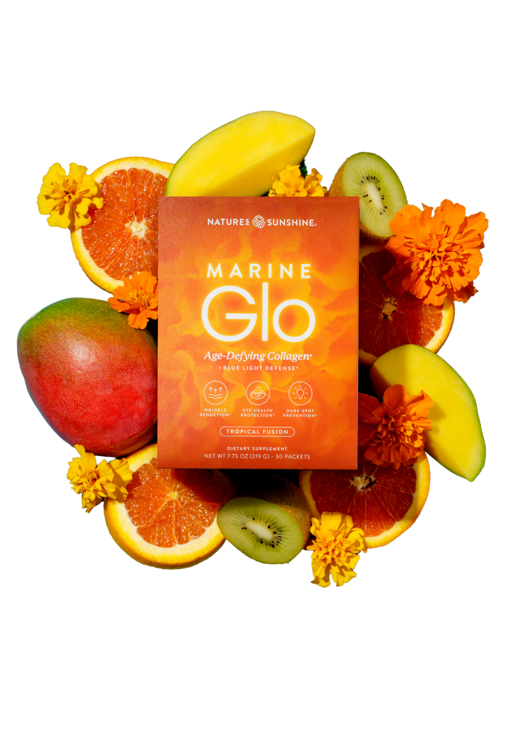
The most common customer objections
“It’s too expensive.”
Response:
Marine Glo is more than just collagen.
It is a comprehensive blend of:
✔ 5 g of collagen
✔ FloraGLO®
✔ vitamin C
✔ biotin
✔ niacin
“I already take collagen.”
Response:
Great.
Does it also contain vitamin C, biotin, niacin and branded FloraGLO® Lutein?
“I don’t like tablets.”
Response:
Marine Glo comes in the form of a tropical-flavored drink.
One sachet per day.

Slide 27


